Slide 1
GUI PRESENTATION
Presented By : Kailas Landge

Slide 2
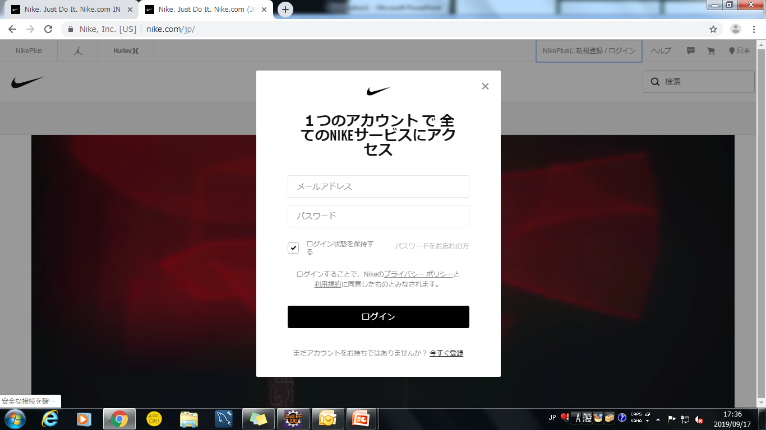
sign in page
1
2
3
4
5
6
7
8

Slide 3
The logo of website shown in center of the page and panel
The block is in center of the page and in background is playing video.
Email address text field simple with place holder Email address
Password text field also simple with place holder Password
One checkbox is there to keep me login so do not login again and again
Small link is given forgot password and it is 50% blur
Login button has large in size and black in background color
One link is given to register the new user

